Slide 1
Assignment 3: Data Visualization
Team Name: Group 2
Team members: Pranali Kanade
Ankita Patidar
Pranjal Srivastava

Slide 2
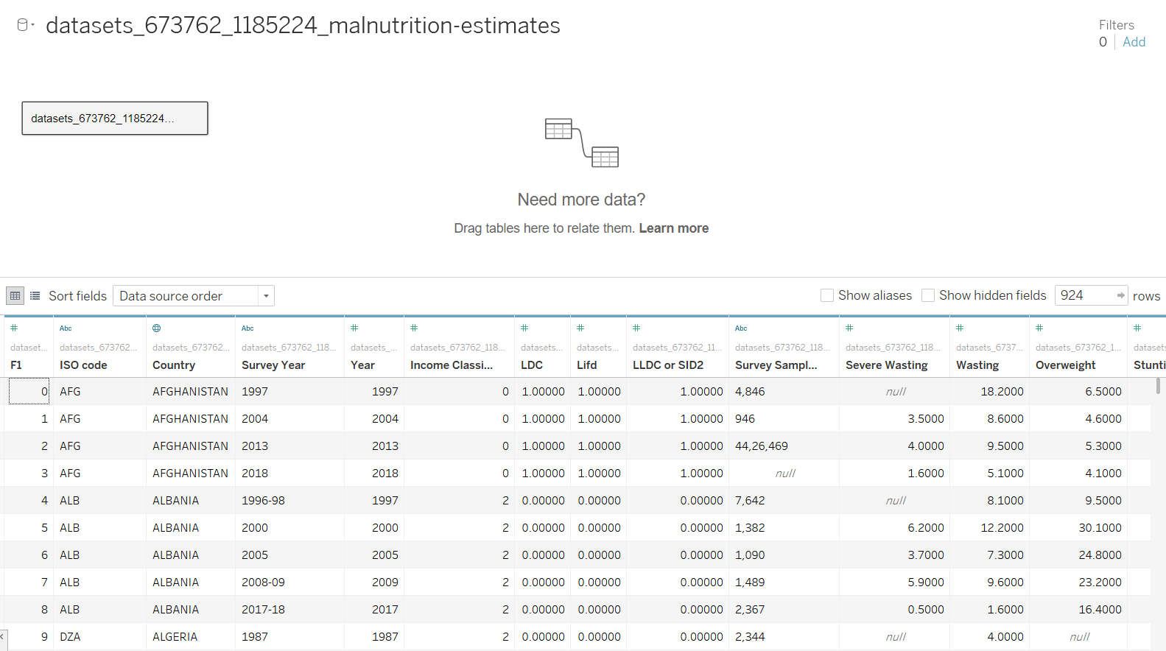
Dataset: Malnutrition Dataset

Slide 3
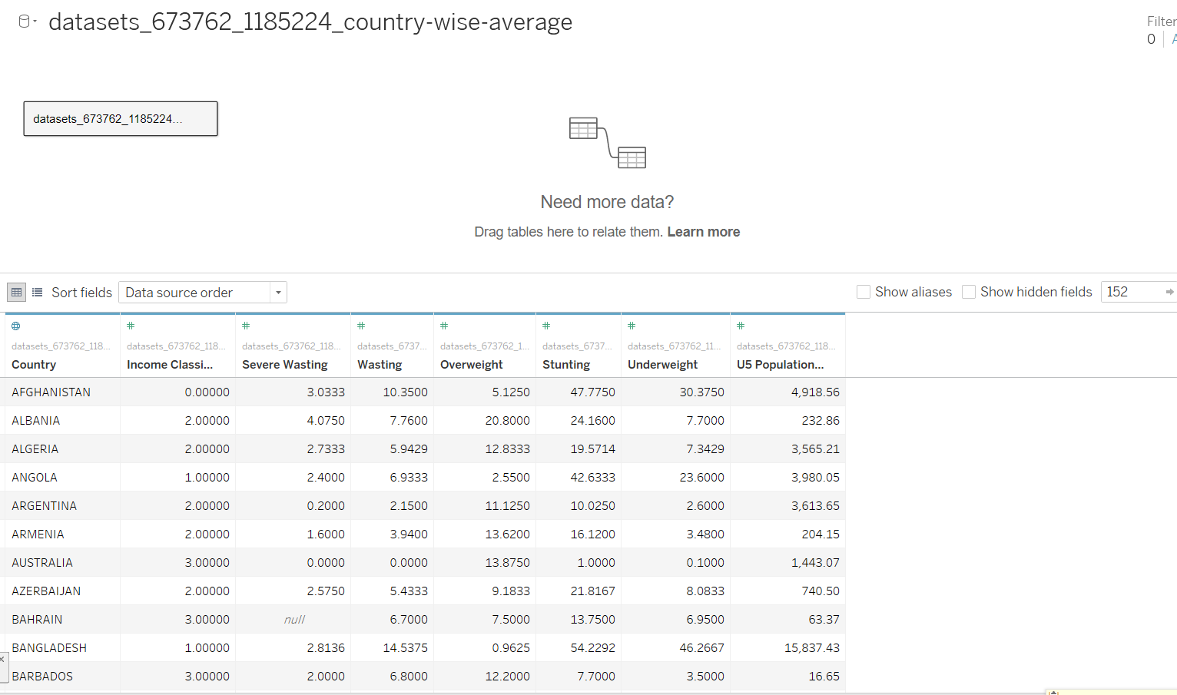
Dataset: Country wise Average

Slide 4
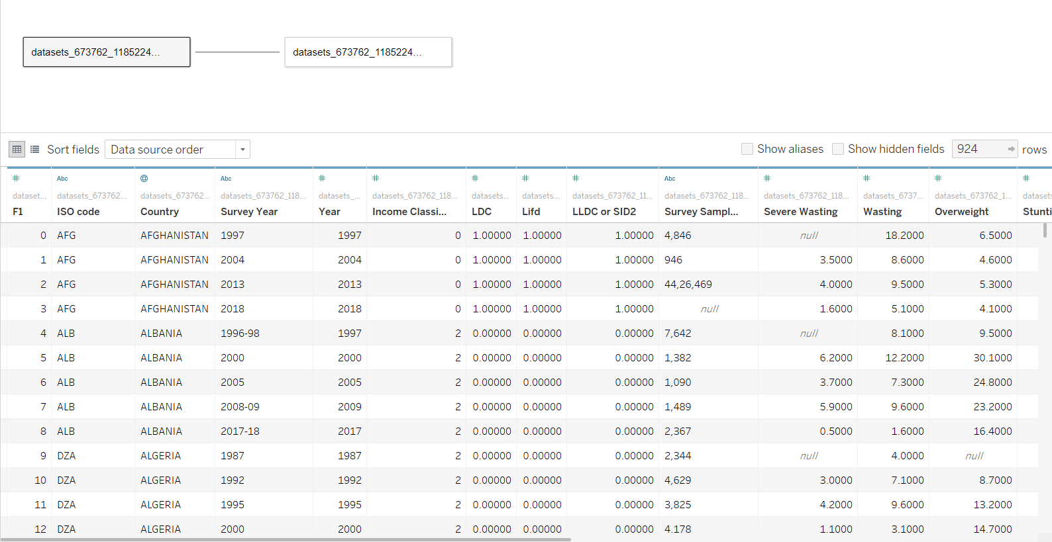
Both Dataset joined

Slide 5
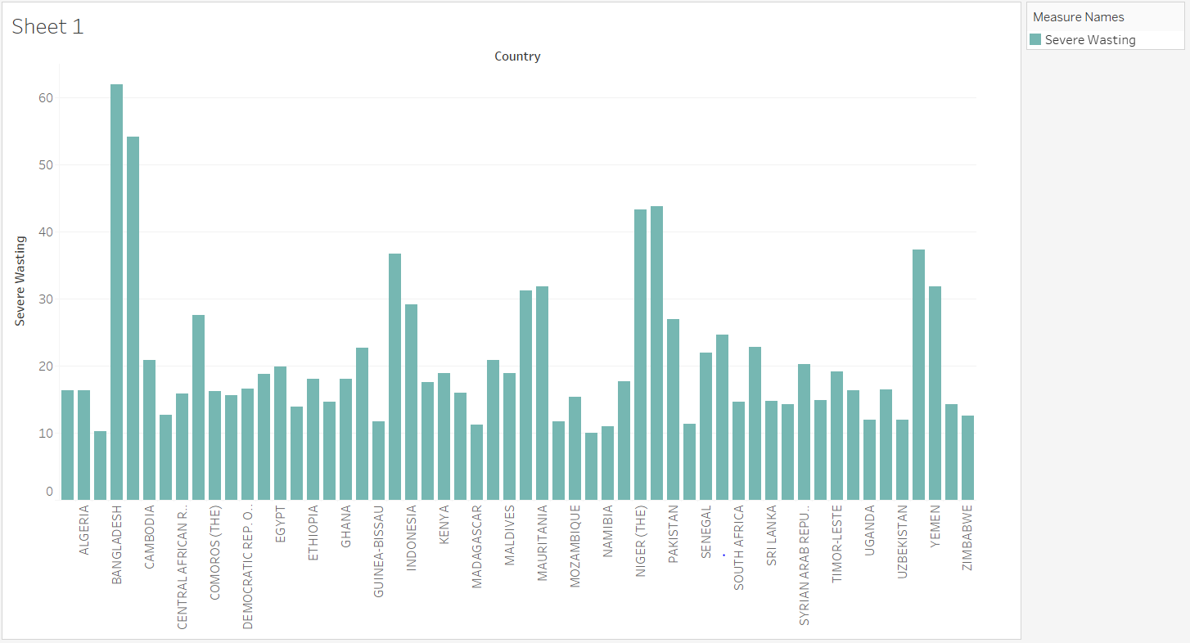
Severe wasting per country

Slide 6
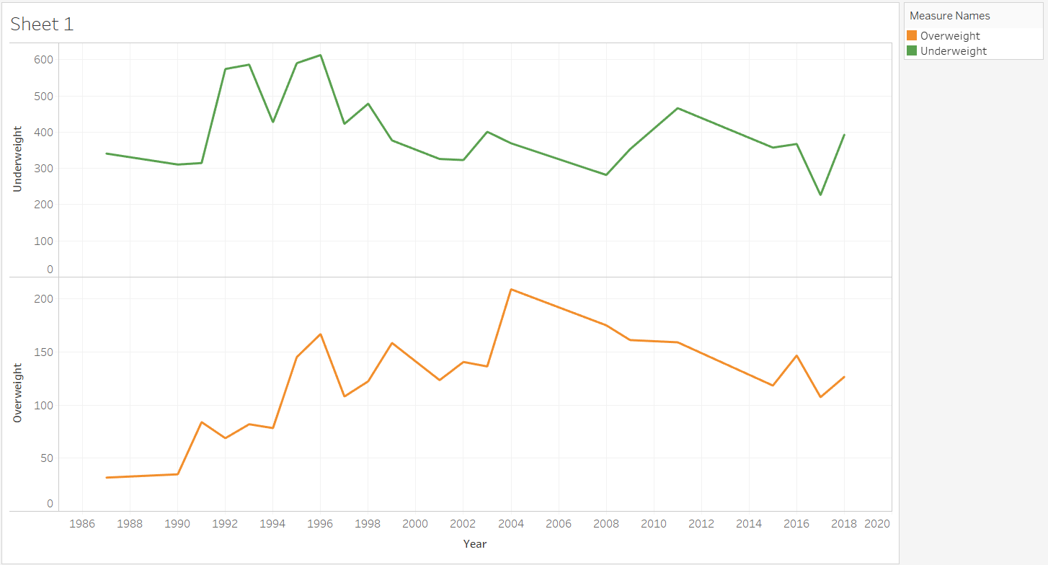
Underweight and Overweight per Year

Slide 7
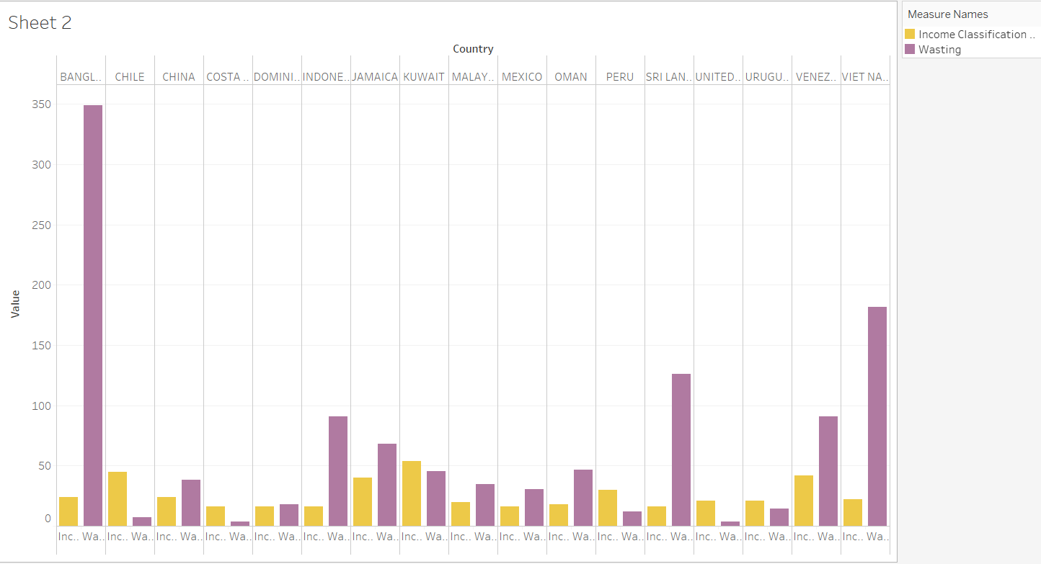
Wasting and Income Classification per Country

Slide 8
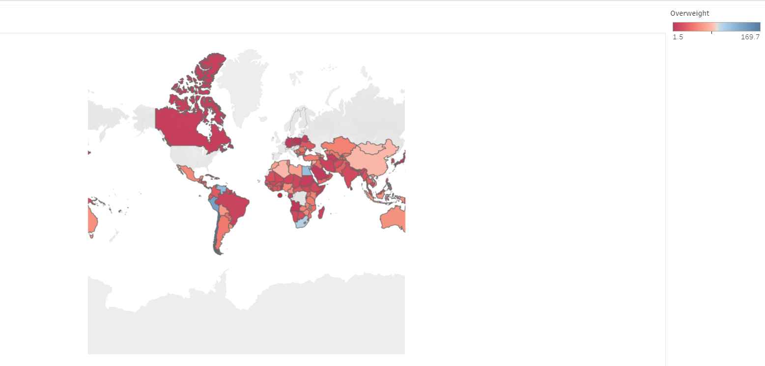
Overweight per country

Slide 9
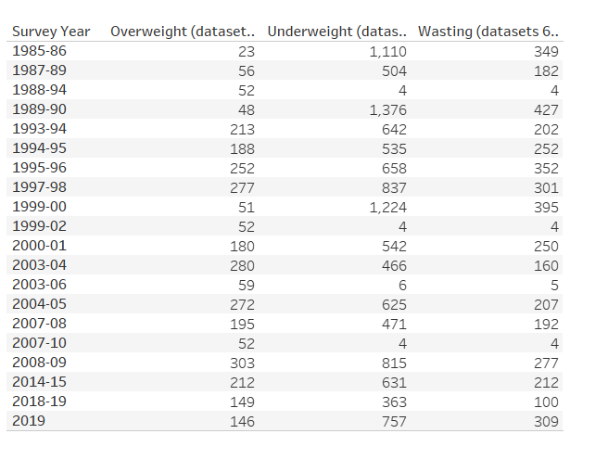
Overweight, Underweight and wasting per Survey Year

Slide 10
Key Findings
Finding 1: UKRAINE is the country with maximum overweight and BANGLADESH with minimum overweight with average as 26.5 and 0.9625 respectively.
Finding 2: AUSTRALIA has least underweight and BANGLADESH has maximum underweight with average of 0.1 and 46.26667 respectively.
Finding 3: Wastage of food is minimum in AUSTRALIA and maximum in SOUTH SUDAN with average of 0 and 23.65 respectively and average of severe wastage is 0 and 11.4.

Slide 11
Key Findings
Finding 4: Year 2000 had maximum overweight in ALBANIA and minimum overweight from DEMOCRATIC PEOPLE'S REP. OF KOREA (THE) for year with estimate as 30.1 and 0 respectively.
Finding 5: AUSTRALIA during year 1995 had minimum underweight with estimate of 0 and BANGLADESH had maximum underweight with estimate of 66.8 during 1986.
Finding 6: For 1995 and 2007 AUSTRALIA had minimum wasting with estimate of 0. NIGER (THE) had maximum wastage of 25.3 during 1985.

Slide 12
Thank you

